Slide 1




West Virginia Department of
Health and Human Resources
Budget Presentation

Slide 2

DHHR Mission Statement
The mission of the West Virginia Department of Health and Human Resources (DHHR) is to promote, protect, manage, and provide appropriate health and human services for our residents to improve their health, well-being, and quality of life.

Slide 3
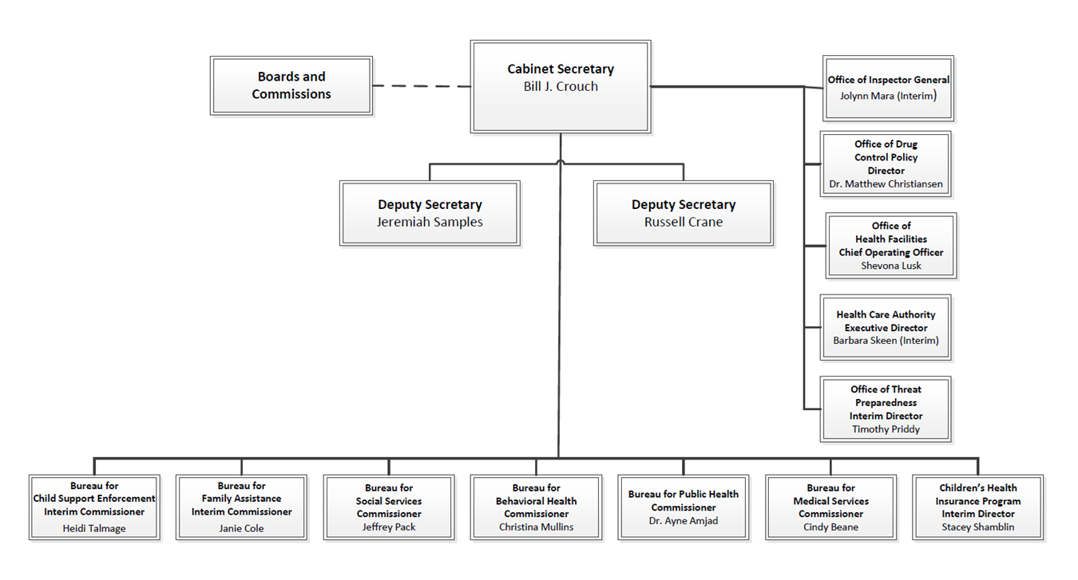
Organizational Structure

Slide 4
Secretary’s Priorities
COVID-19 Pandemic Response
Child Welfare Reform
Mental Health Reform

Slide 5
COVID Expenditures
Cumulative to date spend

Slide 6
COVID Categorical Breakdown
Cumulative to date spend
Medical Service payments include increased FMAP for Medicaid, COVID testing and test kits.
Case/Client Services include payment for LIHEAP, Child Care, increased FMAP for foster care and adoption, and PEBT food benefits. PEBT food benefits are not processed through the State Accounting System. They are paid directly from federal line of credit to retailers.
Specimen Collection is included in contractual.

Slide 7
COVID Federal Awards

Slide 8
COVID Federal Awards - Cont.
PEBT food benefits are not processed through the State Accounting System. They are paid directly from the Federal Line of Credit to retailers. Funding provided for calculated benefit for each state. Amount represents expenditures for SFY2020 and SFY2021.
** Period is entire span of funding for CFDA. There are multiple awards with differing periods of performance that fall within the overall span.

Slide 9
Child Welfare Reforms
BCF reorganization to enhance leadership focus
Workforce Improvements
    Enhanced focus on staff retention
    Workforce Study by WVU
Implementation of children’s mental health services throughout the state
Implementation of new child welfare IT system
Management of state and federal reforms

Slide 10
Mental Health Reforms
Substance Use Disorder Efforts
Adult Competency and Commitment Reform
Mental Health Crisis Efforts

Slide 11
DHHR Budget

Slide 12
Full Time Employees by Bureau
* Other includes: Management Information Services, Human Resources Management, Administration (Finance and Operations), Inspector General, Secretary’s Office, Communications, General Counsel, Tiger Morton, Women’s Commission, Deaf and Hard of Hearing, Developmental Disabilities Council, Office of Drug Control Policy, Constituent Services, Center for Threat Preparedness

Slide 13
Vacant FTEs by Salary Tier

Slide 14
DHHR Budget by Funding Source SFY2023
Special Revenue excludes duplication

Slide 15
DHHR Budget SFY2023
Other includes: Management Information Services, Human Resources Management, Administration (Finance and Operations), Inspector General, Secretary’s Office, Communications, General Counsel, Tiger Morton, Women’s Commission, Deaf and Hard of Hearing, Developmental Disabilities Council, Office of Drug Control Policy, Constituent Services, Center for Threat Preparedness

Slide 16
SFY 2023 Improvements

Slide 17
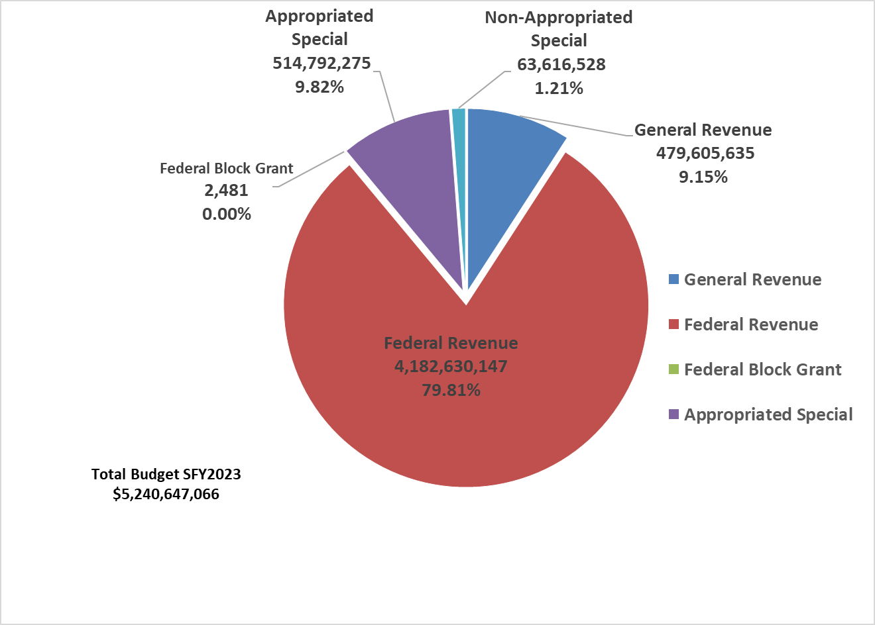
Bureau for Medical Services
Federal revenue represents spending authority appropriation – Amount authorized to spend if federal awards and expenditures occur as estimated.

Slide 18
Overview of Medicaid Budget
      Largest portion of DHHR budget
      Federally funded with traditional, expansion, and administrative match rates
      With savings, the Justice Administration has been able to:
        Increase rates for multitude of providers
        Provide funding to hospitals through Save Our Care

Slide 19
Medicaid Six-Year Plan
Reasons for Medicaid Surplus
Increased federal match of approximately $50M per quarter. Currently, the 6.2% federal pandemic match will be available through end of SFY2022.
Decreased utilization during pandemic.
Long-term budget management to ensure solvency.

Slide 20
Medicaid Budgetary Drivers and Risks
    Increase in medical claims due to Covid-19 Public Health Emergency
    Increased enrollment
    Policy decisions to increase payments to providers
    Increased costs due to aging population
    Drug epidemic
    Risk of reduction or loss of federal matching funds once the PHE enhanced 6.2% FMAP is gone
    Lawsuits/court orders to expand benefits/payments
    Increased Rx costs due to new drugs entering market

Slide 21
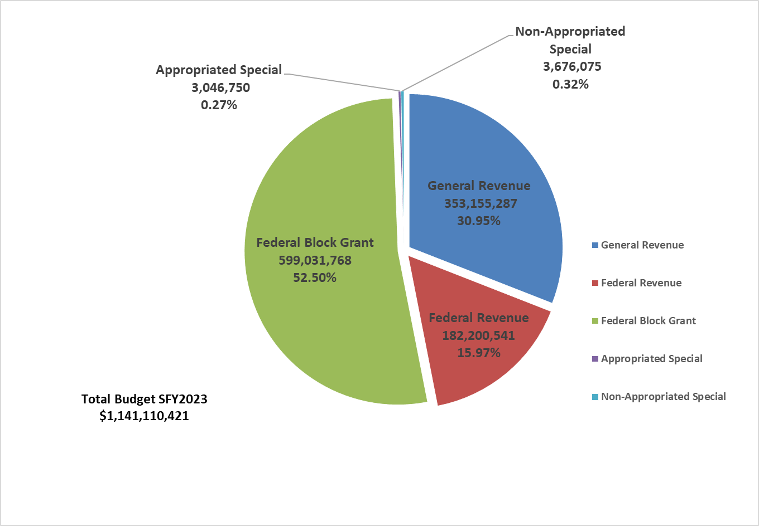
Bureau for Children and Families
(Bureau for Family Assistance/Bureau for Social Services)
Federal revenue represents spending authority appropriation – Amount authorized to spend if federal awards and expenditures occur as estimated.

Slide 22
BFA Budgetary Drivers and Risks
Decrease/change in TANF funding
Child Care Subsidy federal changes
SNAP Error Rates
Expansion of services via Legislature, Congress

Slide 23
BFA Priorities
Effectuating the BCF to BFA/BSS Reorganization
Increasing workforce participation rate for BFA clientele
Improving case management quality control and reducing error rates
Building a robust network of community supports that lead to personal and economic self-sufficiency

Slide 24
BSS Budgetary Drivers and Risks
Child welfare crisis
Adult Services growth
DOJ (Department of Justice) and FFPSA (Family First Prevention Services Act) impact in the use of evidence-based services and service expansion
Facility costs at West Virginia Children’s Home (state-operated facility)

Slide 25
BSS Priorities
Effectuating the BCF to BFA/BSS Reorganization
Stabilize our Workforce
Utilize Technology
Encourage Mental Health/Behavioral Services

Slide 26
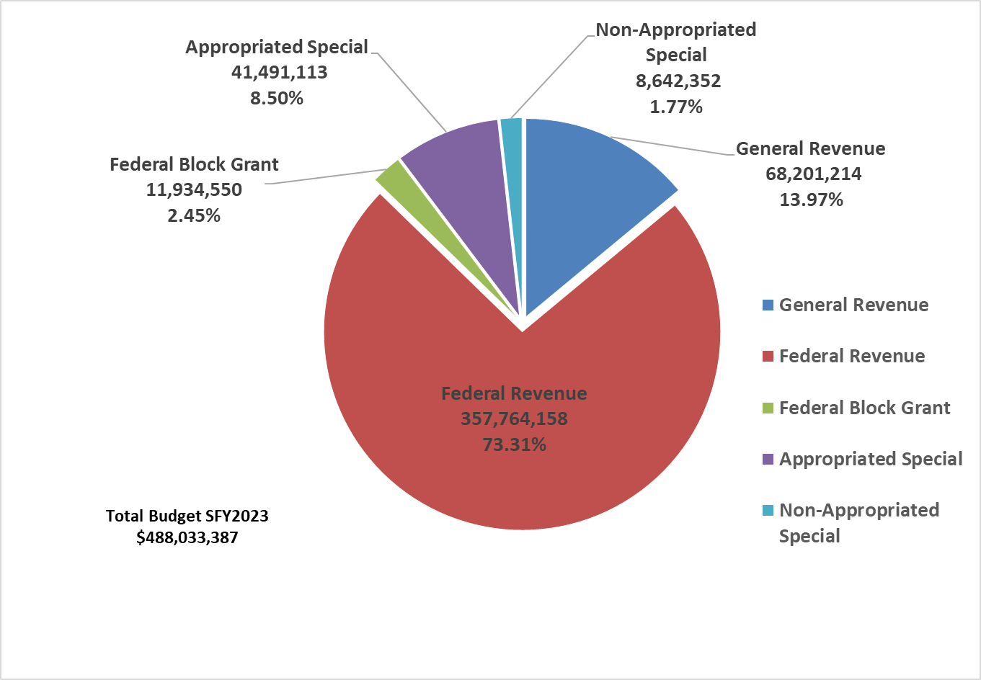
Bureau for Public Health
Federal revenue represents spending authority appropriation – Amount authorized to spend if federal awards and expenditures occur as estimated.

Slide 27
BPH Budgetary Drivers and Risks
COVID-19 related expenditures
State Labs and Medical Examiner facility failures
Infectious disease outbreaks (HIV, Hepatitis, Zika, etc.)
Birth-to-Three enrollment increases
Medical Cannabis program

Slide 28
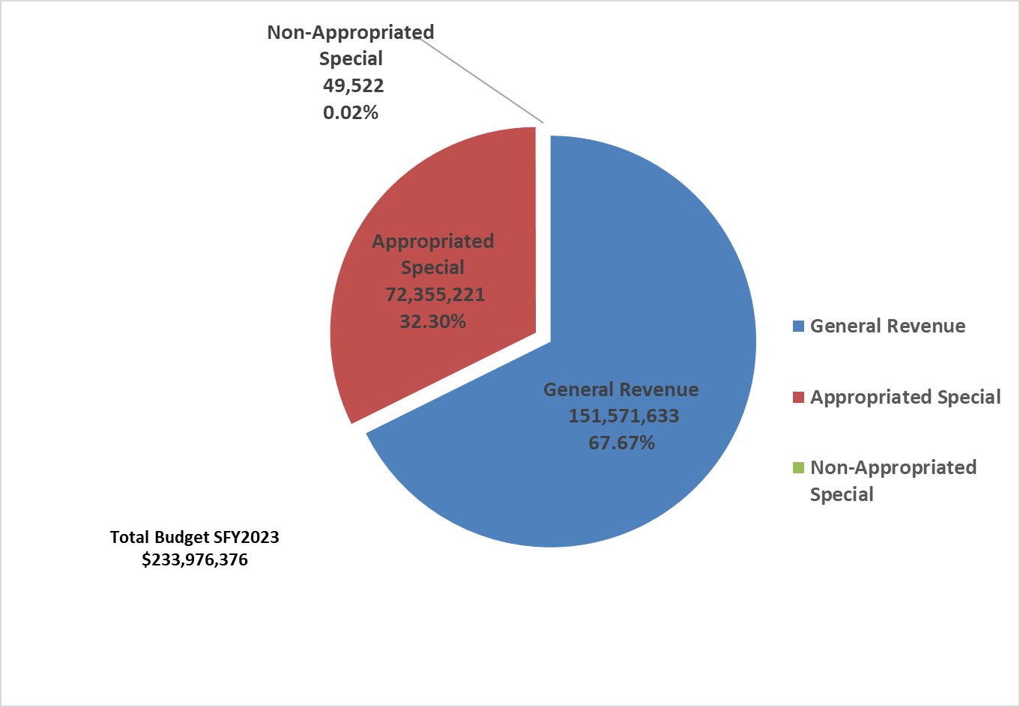
Office of Health Facilities

Slide 29
State Hospital Metrics
He
Hospital Name | Location | Built | Type | Bed Capacity
Hopemont | Terra Alta, Preston County | 1913 – Renovated 1956 | Nursing Home | 98 Licensed 52 Bed Capacity 49 Census
Jackie Withrow | Beckley, Raleigh County | 1927 | Nursing Home | 199 Licensed 75 Bed Capacity 58 Census
John Manchin Jr. | Fairmont, Marion County | 1899 – Renovated 1980 | Nursing Home, Outpatient Clinic | 41 Nursing Home 38 Bed Capacity 28 Census
Lakin | West Columbia, Mason County | 1926 – Renovated 1974 | Nursing Home | 114 Licensed 65 Bed Capacity 59 Census
Welch | Welch, McDowell County | 1902 – Renovated 1984 | Nursing Home, Acute Care Hospital | 27 Long Term Care 55 Acute Care 15 LTC Census 10 Acute Census
Bateman | Huntington, Cabell County | 1950 | Psychiatric Hospital | 110 Licensed 93 Census
Sharpe | Weston, Lewis County | 1990 | Psychiatric Hospital | 200 Licensed 177 Census

Slide 30
Facilities Budgetary Drivers and Risks
Continued annual operational losses
Increases in contractual staff expenditures (including crisis rate for contract staff)
Capital outlays and maintenance
Emergency equipment or facility structural issue
Increases in diversions (involuntary commitments by court)
Court orders dictating payments

Slide 31
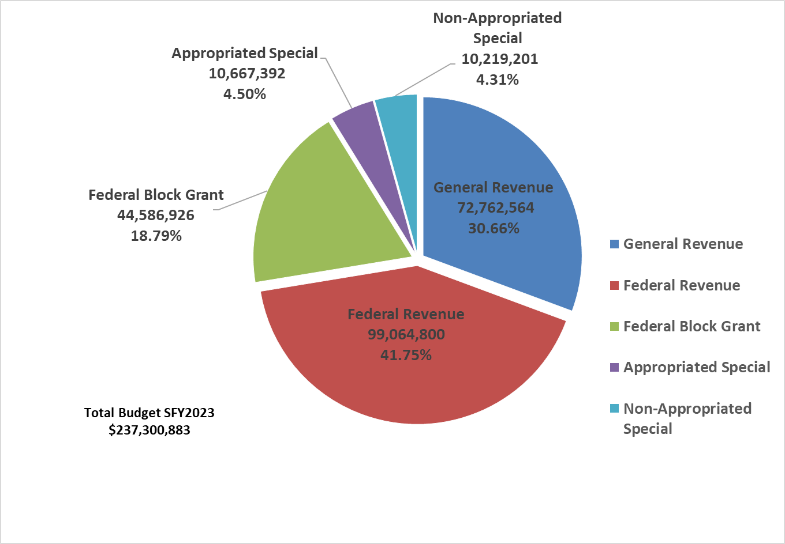
Bureau for Behavioral Health
Federal revenue represents spending authority appropriation – Amount authorized to spend if federal awards and expenditures occur as estimated.

Slide 32
BBH Budgetary Drivers and Risks
SUD Epidemic
COVID-19 behavioral health aftershocks
Decrease in federal funding
Lawsuits/court orders
Provider shortages in community mental health for adults and children
Group home management

Slide 33
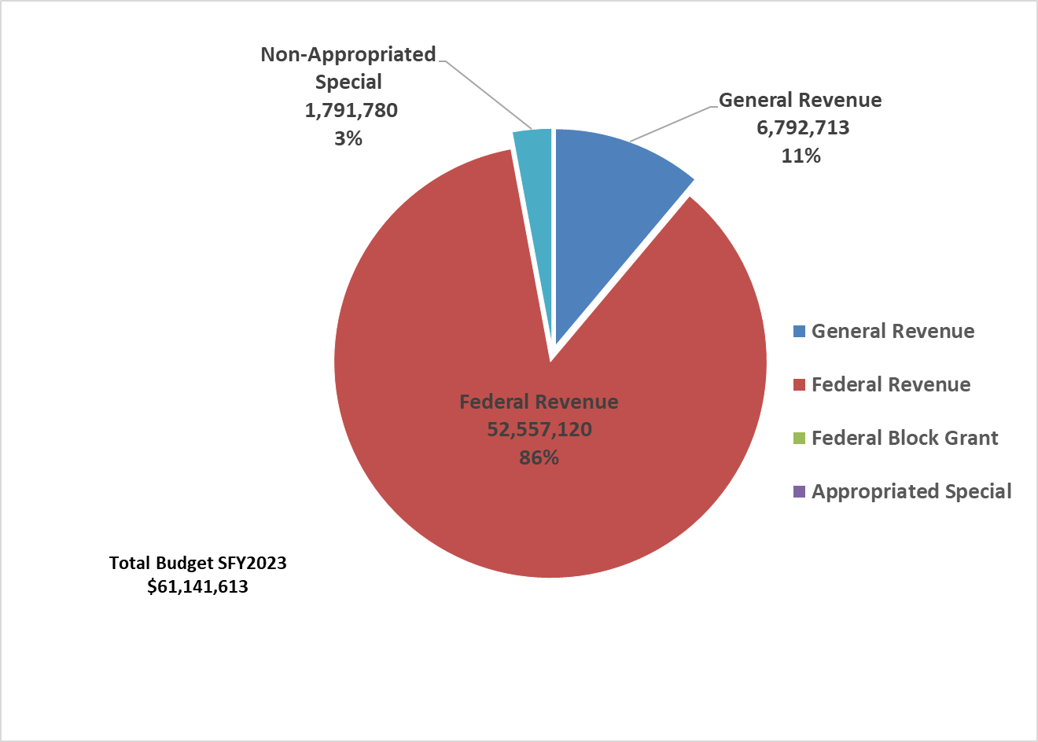
Children’s Health Insurance Program
Federal revenue represents spending authority appropriation – Amount authorized to spend if federal awards and expenditures occur as estimated.

Slide 34
CHIP Budget Overview and Risks
    CHIP Overview
    Covers children and pregnant women up to 300% of the federal poverty Level
    Serves average of 20,000 children and 250 pregnant women at any point in time. CHIP also pays for approximately 13,000 children on Medicaid
    CHIP federal match rate been slightly increased to 85% during the pandemic and will drop to 81.814% for FFY2023
    Risks
    Increased expenditures due to COVID, increased enrollment, etc.
    Risk of reduction or loss of federal matching funds
    Policy decisions to increase payments/expand benefits

Slide 35
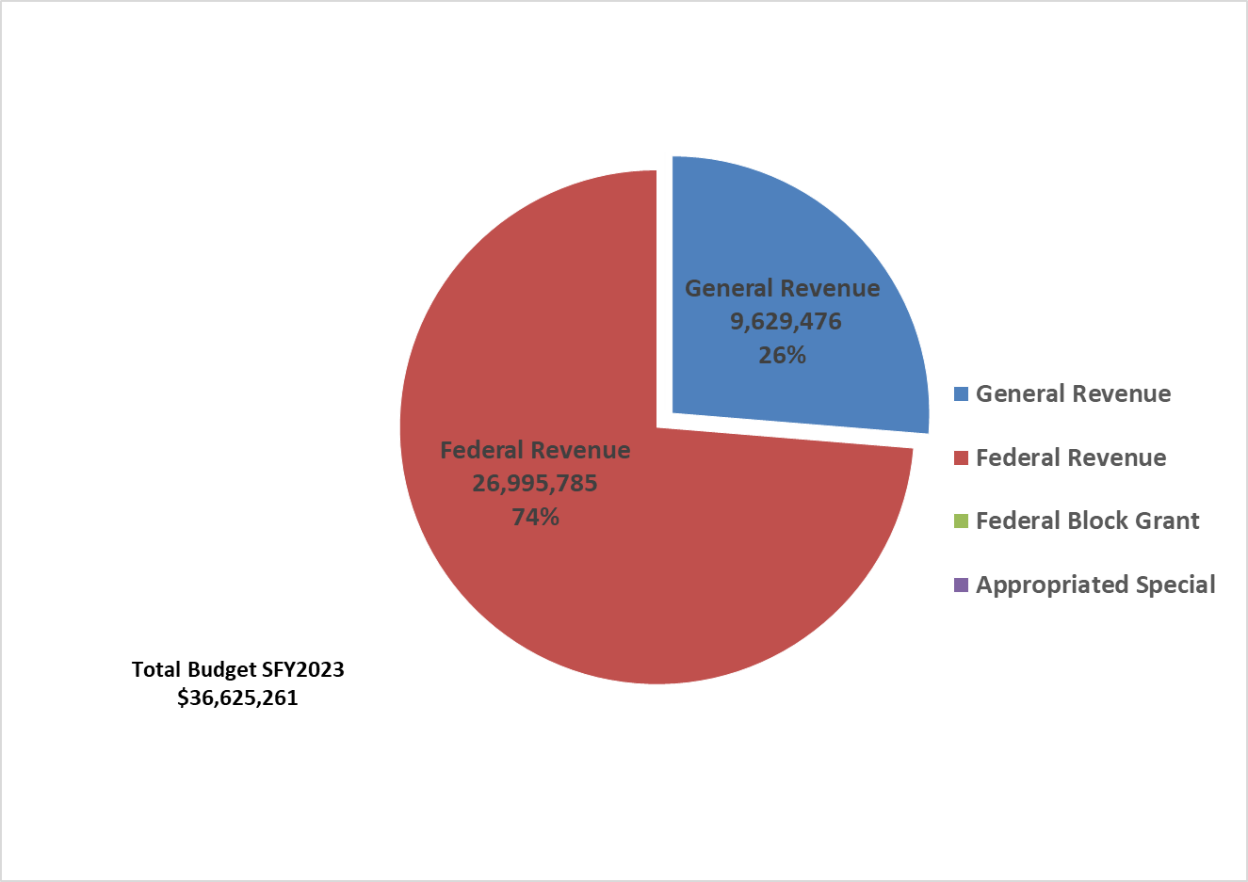
Bureau for Child Support Enforcement

Slide 36
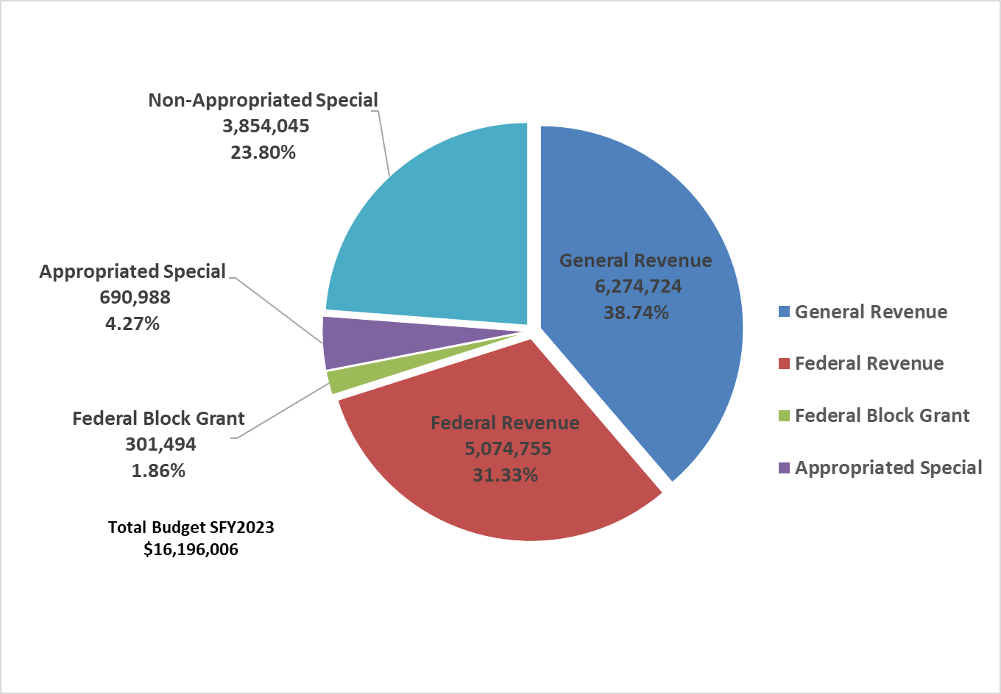
Office of Inspector General
Federal revenue represents spending authority appropriation – Amount authorized to spend if federal awards and expenditures occur as estimated.

Slide 37
Other DHHR Budgetary Risks and Issues
Federal match changes for DHHR IT systems
Telephone and internet failures
Capital costs for owned/leased properties
Inability to recruit and retain staff
Unfunded federal and state mandates

Slide 38
Addendum
Budget Detail

Slide 39
SFY2023 Improvements
State share of DHHR improvements included in Governor’s Budget:

Slide 40
DHHR Budget by Funding Source SFY2023

Slide 41
Department General Revenue SFY2023

Slide 42
Department General Revenue Appropriation history
 | DHHR Appropriation History
 | General Revenue
 | SFY2017 | SFY2018 | SFY2019 | SFY2020 | SFY2021 | SFY2022
0400 - Office of the Secretary | 806,330 | 645,927 | 655,996 | 667,244 | 667,244 | 667,244
0403 - Division of Human Services | 818,038,421 | 845,313,443 | 892,645,201 | 975,720,261 | 842,957,558 | 882,511,249
0407 - Division of Health | 71,855,218 | 77,608,774 | 76,325,709 | 90,324,981 | 82,617,343 | 73,863,941
0416 - Human Rights Commission | 1,119,276 | 1,346,777 | 1,374,653 | 1,419,645 | 1,419,645 | 1,419,645
0525 - Consolidated Medical Services Fund | 179,469,994 | 209,375,889 | 208,953,702 | 238,797,522 | 231,618,154 | 225,133,154
0561 - W Virginia Drinking Water Treatment | 647,500 | 647,500 | 647,500 | 647,500 | 647,500 | 647,500
TOTAL | 1,071,936,739 | 1,134,938,310 | 1,180,602,761 | 1,307,577,153 | 1,159,927,444 | 1,184,242,733

Slide 43
Office of the Secretary

Slide 44
Division of Human Services

Slide 45
Division of Human Services, cont.

Slide 46
Division of Health

Slide 47
Division of Health, cont.

Slide 48
Division of Health, cont.

Slide 49
Division of Health, cont.

Slide 50
Division of Health, cont.

Slide 51
Department Federal Revenue SFY2023

Slide 52
Department Special Revenue SFY2023

Slide 53
Department “Other” Funding SFY2023

Slide 54
“Other” Funding SFY2023, cont.

Slide 55
Contact Information
Bill J. Crouch
Cabinet Secretary
West Virginia Department of Health and Human Resources
One Davis Square, Suite 100 East
Charleston, WV 25301
Phone: (304) 558-0684
Email: DHHRSecretary@wv.gov
Website: dhhr.wv.gov
Jeremiah Samples
Deputy Cabinet Secretary
West Virginia Department of Health and Human Resources
Phone: (304) 356-5405
Email: Jeremiah.Samples@wv.gov
Starlah Wilcox
Chief Budget Officer
West Virginia Department of Health and Human Resources
Phone: (304) 558-2814
Email: Starlah.A.Wilcox@wv.gov

